Slide 1
RAZOR PAGES

Slide 2
As part of the release of .NET Core 2.0, there are also some updates to ASP.NET.
One of those is the addition of a new web framework for creating a “page” without the full complexity of ASP.NET MVC.
New Razor Pages are a slimmer version of the MVC framework and in some ways an evolution of the old “.aspx” WebForms.
WHEN TO USE WHAT?
Razor Page HTML Views | MVC/Web API REST API calls, SOA

Slide 3
What are ASP.NET Razor Pages?
A Razor Page is very similar to the view component that ASP.NET MVC developers are used to. It has all the same syntax and functionality.
The key difference is that the model and controller code is also included within the Razor Page itself.
It is actually recommended to put the PageModel code in a separate file. This is more similar to how we did code behind files with ASP.NET WebForms.
Razor Pages are perfect for simple pages that are read-only or do basic data input.

Slide 4
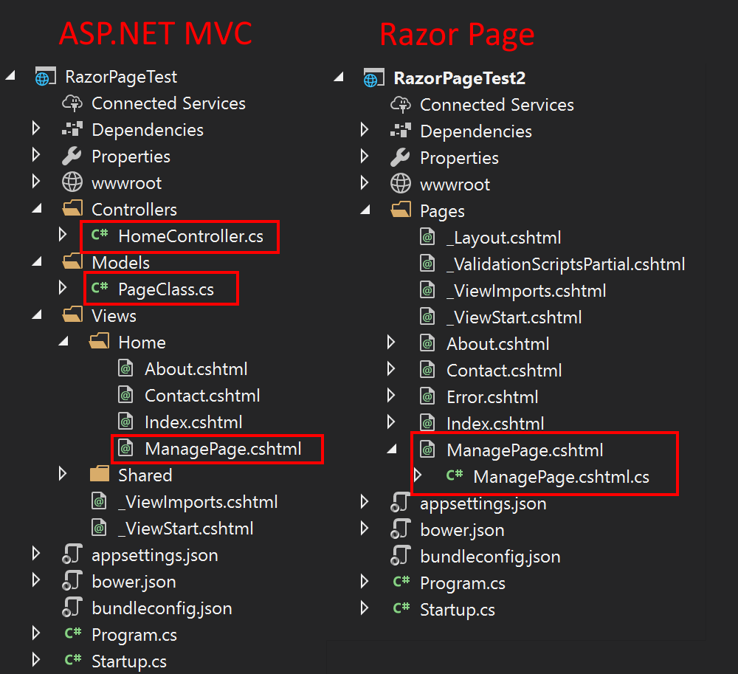
MVC vs Razor Pages

Slide 5
Advantages of Razor Pages
A few very important advantages of Razor pages,
It supports cross-platform, hence it can be deployed on Windows, Unix, and Mac operating systems.
It is easy to learn.
Lightweight and flexible framework so it can fit with any application you want to build.
Can work with C# programming language with Razor markup.
More organized with code behind page like asp.net web forms.

Slide 6
Using Multiple GET or POST Actions via Handlers
By default a Razor Page is designed to have a single OnGetAsync and OnPostAsync method.
If you want to have different actions within your single page you need to use what is called a handler.
You would need this if your page has AJAX call backs, multiple possible form submissions, or other scenarios.
3 different ways to use handlers:
Querystring – Example: “/managepage/2177/?handler=helloworld”
Define as a route in your view: @page “{handler?}” and then use /helloworld in the url
Define on your input submit button in your view. Example: <input type=”submit” asp-page-handler=”JoinList” value=”Join” />

